Slide 1


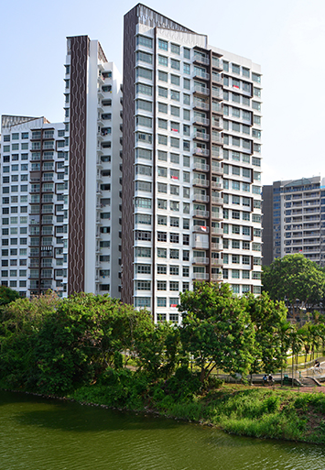

CHANGING DEMOGRAPHICS AND ITS IMPACT ON LOCAL PUBLIC HOUSING PRICES IN SINGAPORE
TEAM 053
RAM CHARAN SINGH
GAN HONG YEE
REGINALD LIM
ARIF RACHMAN
TAI CHIN YAO

Slide 2
Background
In Singapore, the Housing & Development Board (HDB) is tasked with developing public housing estates in a manner that ensures affordability
More than 80% of Singapore’s resident population currently reside in HDB flats
Escalating prices in the past few years have raised concerns regarding the affordability of public housing
Certain demographic groups, especially young couples, find owning their own homes becoming out of reach
Pace of public housing price increases greatly outweighs salary growth

Slide 3
Problem Statement
With the steep increase in housing prices over salary increment, the HDB needs to provide better public housing opportunities for its citizens
 | 2001-2020 | 2021 | 2022
Housing Price to Income Ratio | 4.1 | 4.5 | 4.8
Our project hopes to facilitate better policy planning and outcomes for HDB through the study of the impact that changing demographic structure in Singapore has on the prices of resale public housing flats

Slide 4
Planned Approach
Data Cleaning
Feature Engineering
Feature Selection
Model Building
Model Tuning
Model Selection
Address Missing Values
LOCF
Imputation
Remove Duplicates
Outlier Treatment
QQ plot
Histogram
Grubb’s Test
Merge Datasets
Using year-month identifier
Adjust for inflation
Using Consumer Price Index
Encode Categorical Variables
Create Interaction Variables
Correlation Matrix
Variable Inflation Factor
Principal Component Analysis
Train-Validation-Test Split
70:15:15 ratio
Mean/Median
Stratification across different time periods
Data Scaling
Train Model
Regularization
L1 & L2
Hyperparameter Tuning
Random Search
Grid Search
Adjusted R²
Root Mean Squared Error
AIC/BIC
Cross Validation

Slide 5
Hypotheses
Increase in the younger age group segment (20-59 years) of the population likely to increase the demand of public housing more than other age groups
Increase in the older age group (>= 60 years) segment of the population may decrease the demand of public housing

Slide 6
Models
Multiple linear regression
Polynomial regression
Non-Linear Regression
Regression trees
Random forest

Slide 7
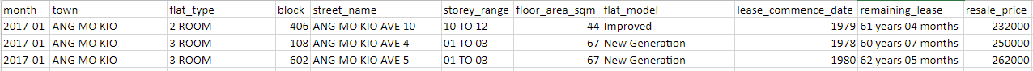
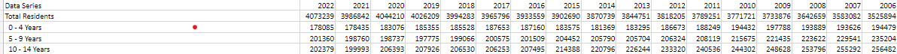
Datasets
Dataset 1: HDB resale data (Source: https://data.gov.sg/dataset/resale-flat-prices)
- 11 Attributes describing public housing such as address, size of the flat and resale price
Dataset 2: Consumer Price Index (CPI) data (Source: https://www.worldbank.org/en/research/brief/inflationdatabase)
- Time series data regarding various countries’ CPI from 1970 to 2022
Dataset 3: Singapore Demographics data (Source: https://www.singstat.gov.sg/find-data/search-bytheme/population/population-and-population-structure/latest-data)
- Demographics consisting of Singapore’s population count, population growth and breakdown by age group covering the period 1950 to 2022

Slide 8
Data Cleaning
Doing imputation on missing recent CPI rate - CPI rate on past month May 2023 is missing, it is imputed from the average of recent months
Merge the 3 separate datasets and align them by year or year/month - HDB resale prices, CPI rate, population numbers
Some text fields are converted to numeric - e.g. "remaining lease" (example 89 years 06 months) are converted into numeric 89.5 years
Data irrelevant to our analysis has been excluded - e.g. CPI rates per item, population by gender and races

Slide 9
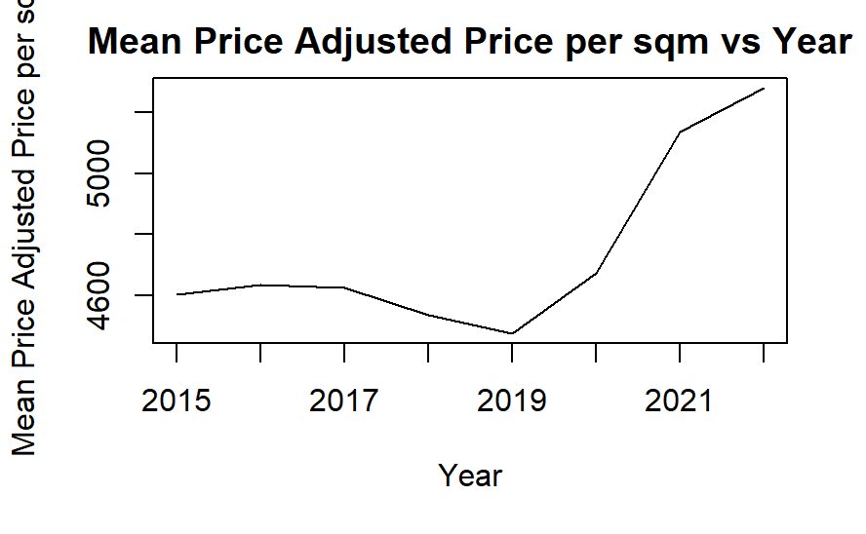
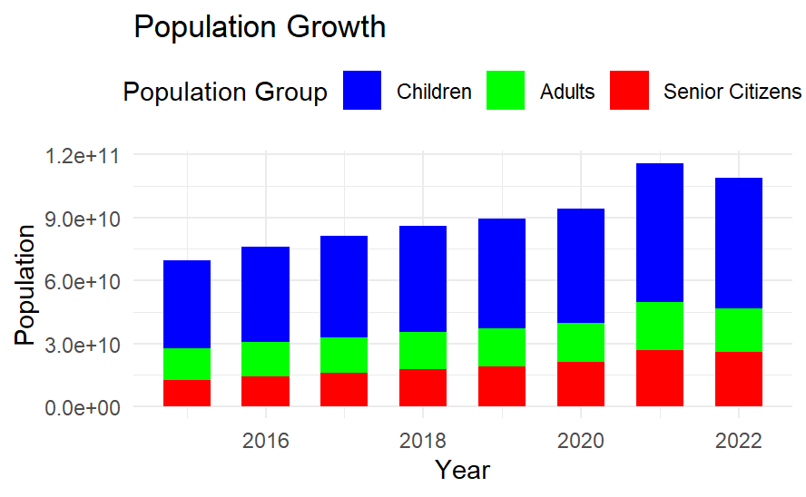
Explanatory Data Analysis
The adjusted price per sqm trend seems to have spiked after 2019.
The population growth trends suggest that this might be one contributing factor.
Mean Adjusted Price per sqm
Year

Slide 10
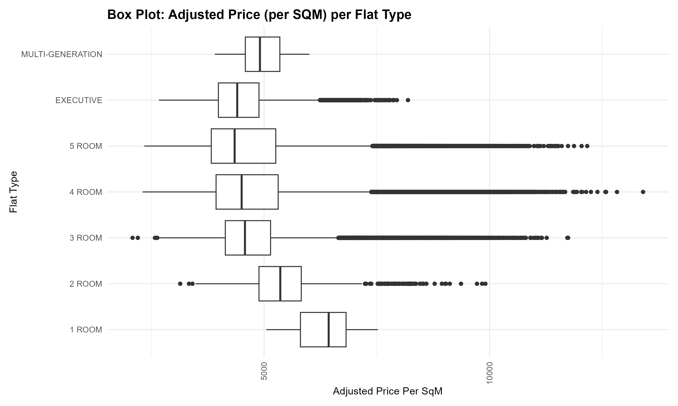
Preliminary Analysis
Based on the box plot, 3, 4 room and 5 room shows the largest proportion of outliers.
Statistical Analysis
 | 3 room | 4 room | 5 rooms
Mean Absolute Deviation | 719 | 965 | 937
IQR | 1003 | 1377 | 1429
Kurtosis | 8.25 | 5.6 | 5.63
Skewness | 1.93 | 1.54 | 1.50
→ Different flat types result in spread in prices or population

Slide 11

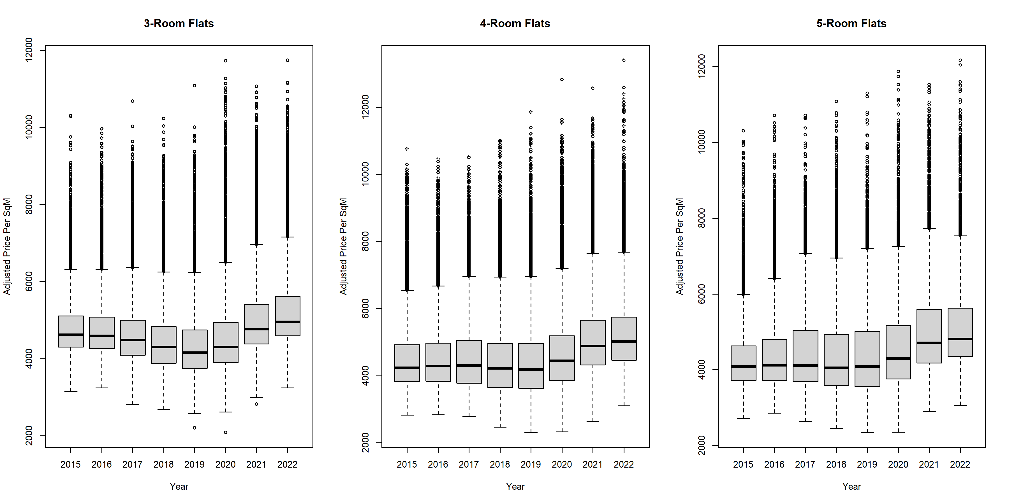


Preliminary Analysis
Splitting by flat area suggests
→ General upward trend
→ 2020 onwards
Notes:
This purpose is to show that previous chart outliers is not due to purely town area higher price but also when we break into different years we are seeing a general trend

Slide 12
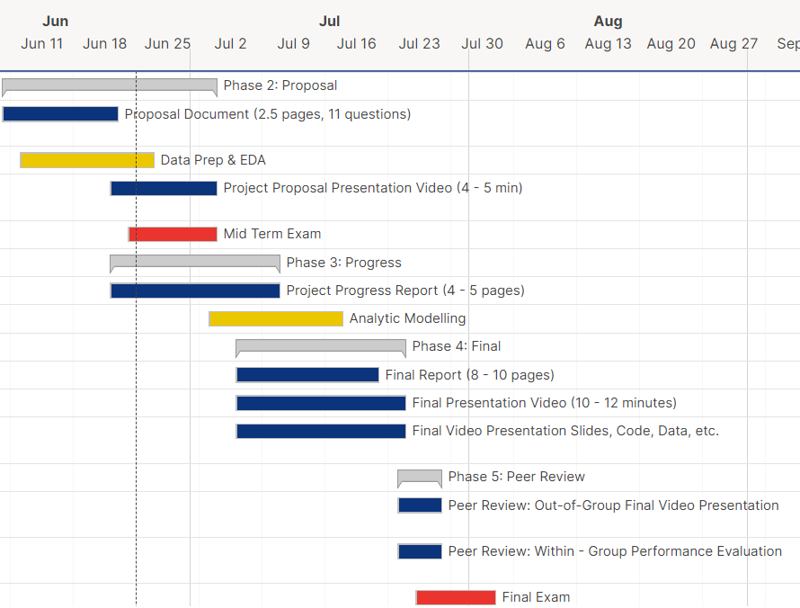
Project Timeline
Data Prep & EDA (In Progress as at time of recording)
Progress Report (In Progress as at time of recording)
Analytic Modelling (Start to Mid-July)
Final documentations (2nd to 3rd week of July)
Peer review (Final week of July)

Slide 13
Sources
[1] “HDB | Public Housing – A Singapore Icon - Housing & Development Board,” https://www.hdb.gov.sg/about-us/our-role/public-housing-a-singapore-icon (accessed June 1, 2023).
[2] “Commentary: Supply-demand imbalances in HDB market will need time to clear,” https://www.channelnewsasia.com/commentary/hdb-public-housing-bto-affordability-accessibility-supply-demand-3259186 (accessed June 15, 2023)
[3] “The Unassuming Economist,” The Unassuming Economist A Look at Housing Affordability in Asia Comments https://unassumingeconomist.com/2019/12/a-look-at-housing-affordability-in-asia/ (accessed June 16, 2023)
[4] “Is Public Housing Still Affordable For The Average Singaporean Couple?” https://blog.seedly.sg/is-public-housing-still-affordable-for-the-average-singaporean-couple/ (accessed June 17, 2023)
[5] “Resale Flat Prices” Data.gov.sg. https://data.gov.sg/dataset/resale-flat-prices (accessed June 12, 2023)
[6] “A Global Database of Inflation,” World Bank. https://www.worldbank.org/en/research/brief/inflation-database (accessed June 12, 2023)
[7] “Population and Population Structure,” Base. https://www.singstat.gov.sg/find-data/search-by-theme/population/population-and-population-structure/latest-data (accessed June 18, 2023)
[8] “How To Adjust For Inflation In Monetary Data Sets,” Time Series Analysis, Regression, and Forecasting https://timeseriesreasoning.com/contents/inflation-adjustment/#:~:text=As%20we%20have%20seen%2C%20you,multiplying%20the%20result%20by%20100.&text=This%20is%20an%20important%20formula (accessed June 17, 2023)

Slide 14
Thank you

Slide 15
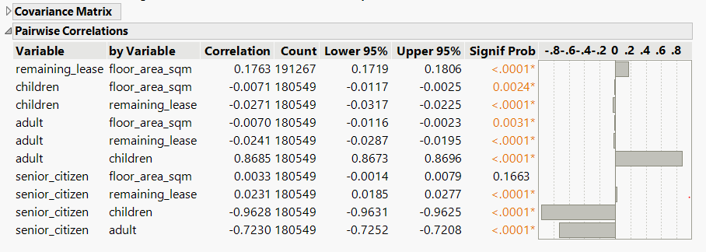
Pairwise Correlation
Strong correlation between adult, children and senior citizen
Notes:
The main objective that you want to talk about this is the correlation exist between the adult, children and senior citizen. It seems that senior citizen has a negative correlation to adult and children.

